Slide 1
Baseball 4D: A Tool for Baseball Game Reconstruction & Visualization
Ivan Ulloa
Raul Martinez
Reference Link:
https://ieeexplore.ieee.org/stamp/stamp.jsp?tp=&arnumber=7042478

Slide 2
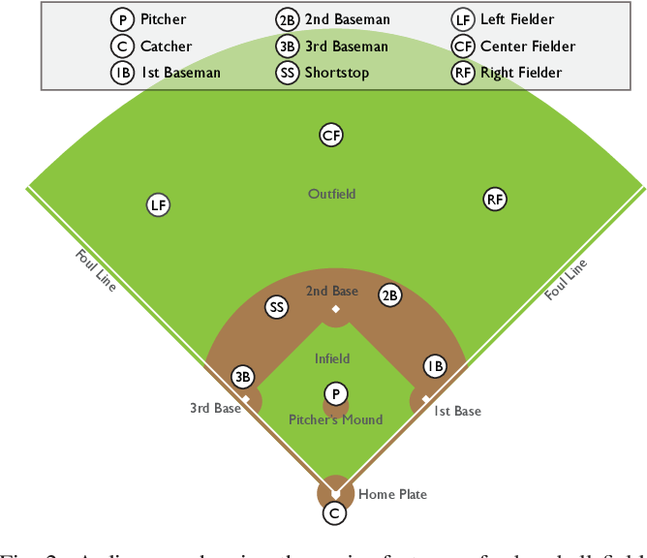
What is it?
Visual analytics tool for baseball games to enable analysis of high-resolution, time varying player and ball 3D tracking data streams.
Technique has been used on over 1,100 games comprised of over 52,000 play segments.

Slide 3
Goals
Go beyond outcome-based statistics (i.e. batting average) so that the entirety of the play, and multiple plays, can be taken into account (i.e. reaction time, speed).
Follow Shneiderman’s visual information mantra: “overview first, zoom and filter, then details on-demand”.

Slide 4
Data Architecture

Slide 5
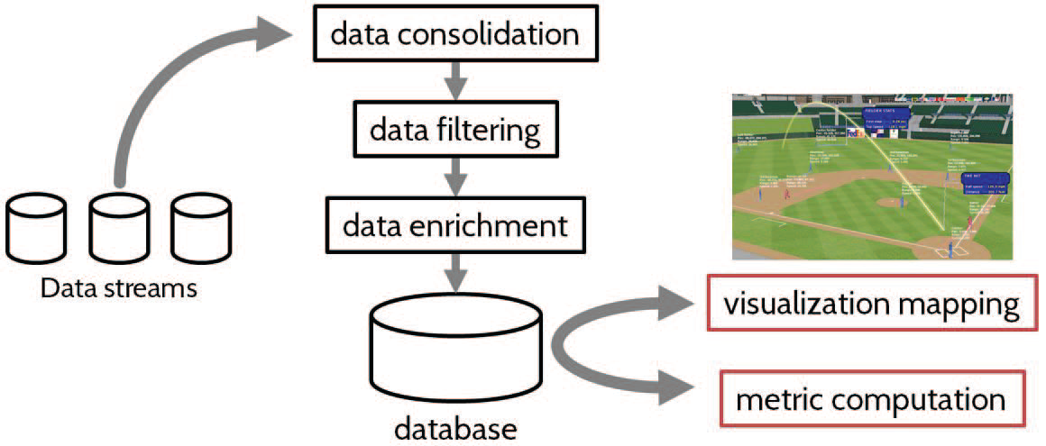
Processing the data streams
Obtained from different hardware.
Needs to be aligned based on timestamps.
Four types of filtering:
Positional: Do not jump around the field.
Timing: Even sampling.
Event: Game events match rules.
Semantic: Snapshots match player, pitch, and game information (i.e. catch cannot occur unless player and ball are in close proximity).

Slide 6
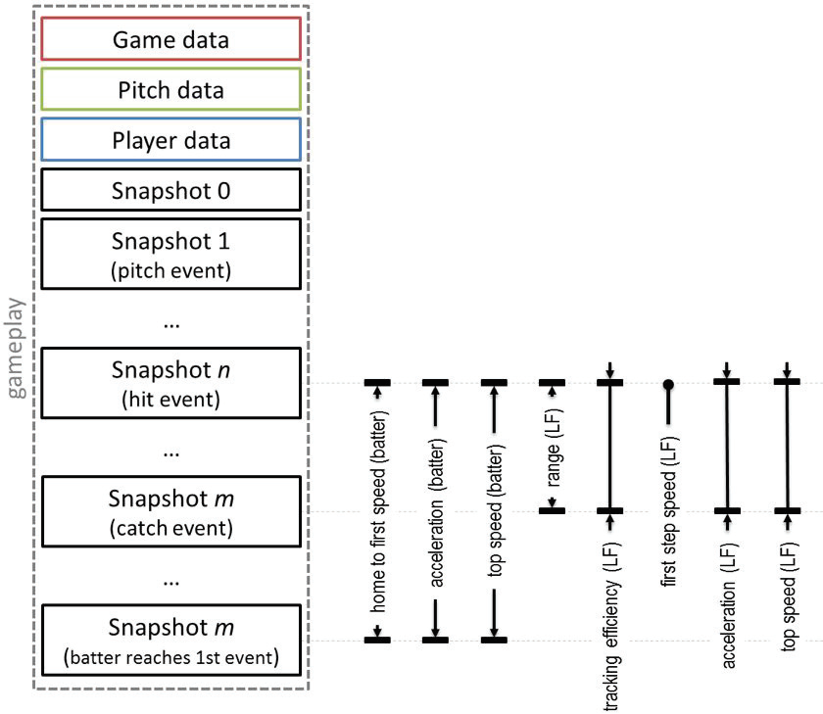
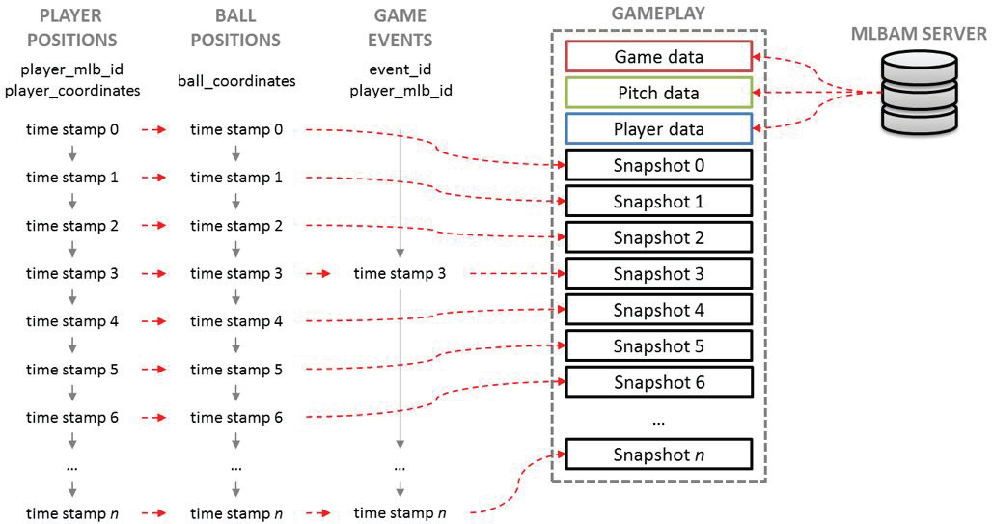
Data integration for gameplay reconstruction
Gameplays are defined between game events and combine all available records in that time range.

Slide 7
Tools and Visualizations

Slide 8
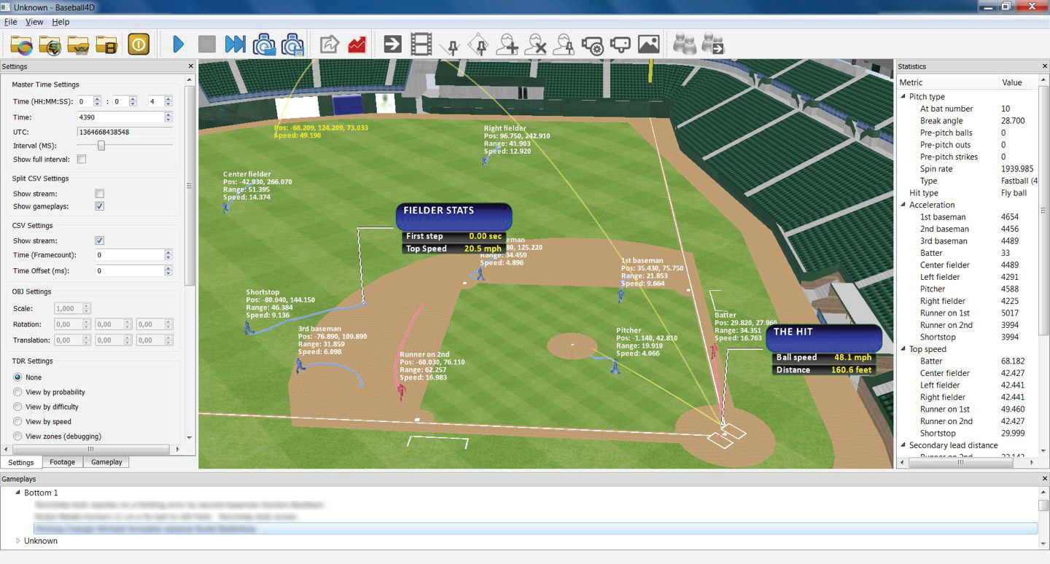
Visual components for play timeline
Interactive views for one or more plays.
Filtering and selecting related statistics and metrics (static and dynamic).
Gameplays on-demand.

Slide 9
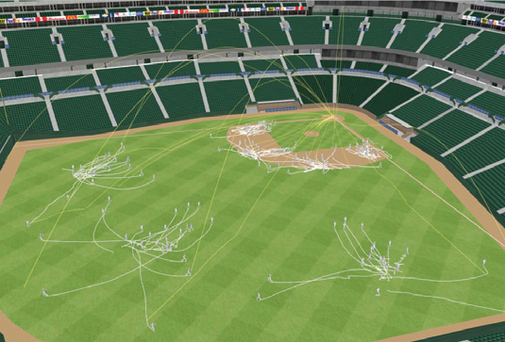
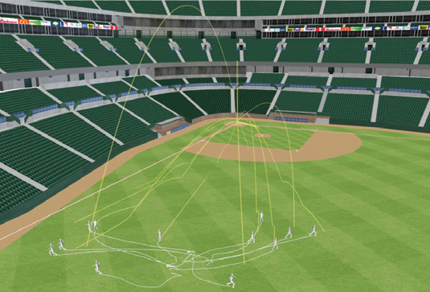
Visual elements highlight player and ball tracks.
Examine fielders position in a game for a specific batter or a particular fielder’s movement during a game.

Slide 10
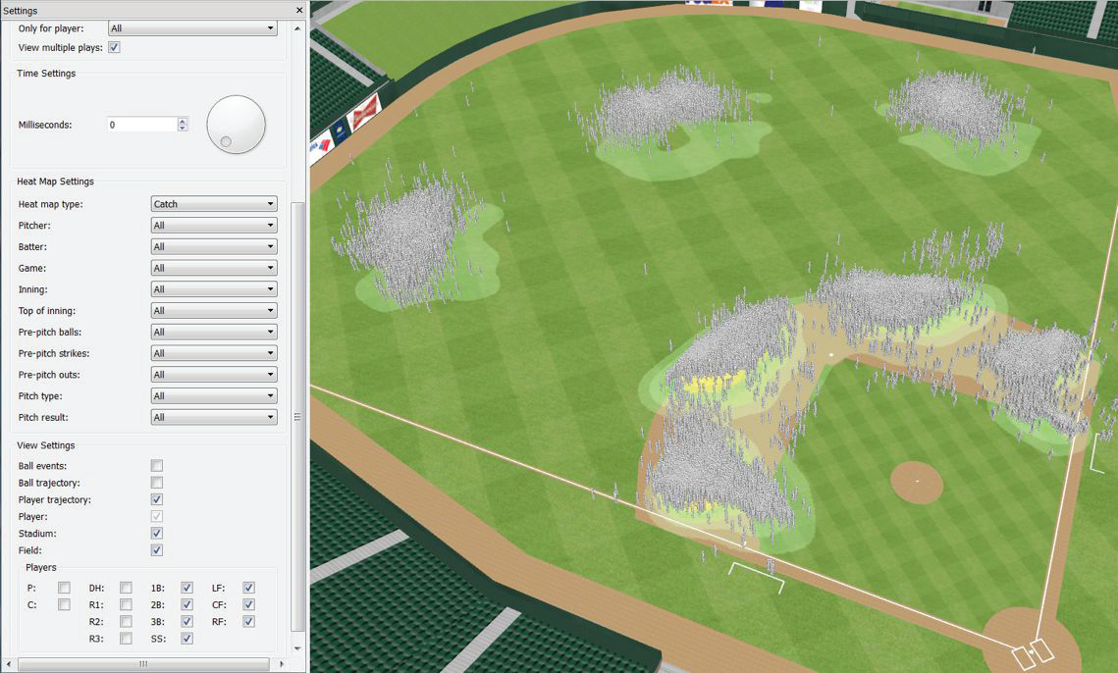
Locations of all hit balls and player positioning at pitch release
Aggregate of plays.
Allows analysts to see how teams or specific players are positioned during a game.
Example: suggests 3rd baseman and shortstop field most of the hits, perhaps higher number of right-handed at bats.

Slide 11
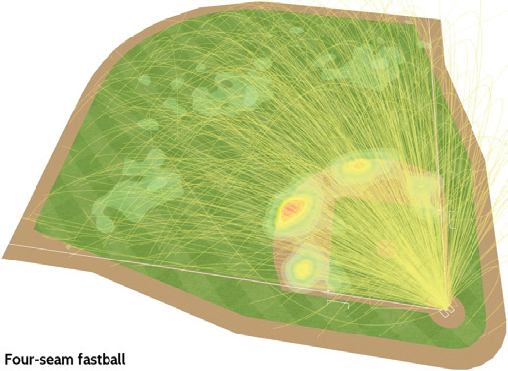
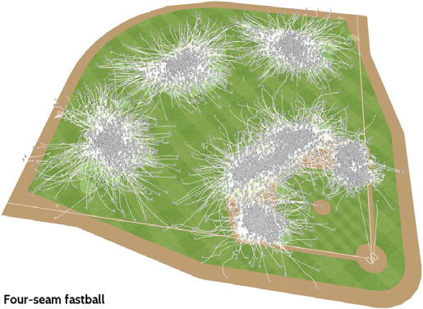
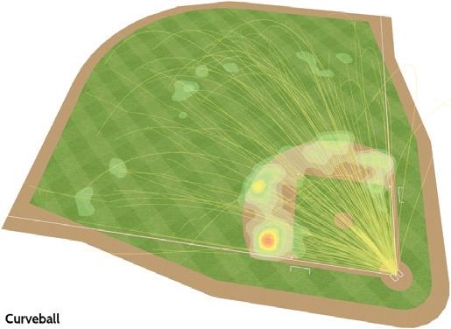
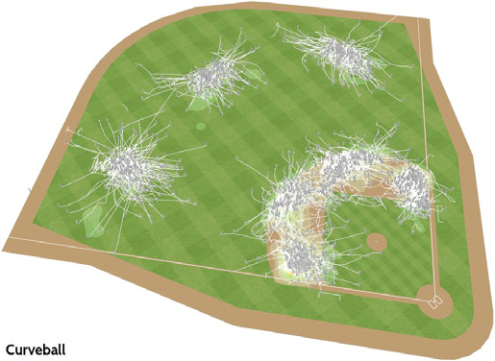
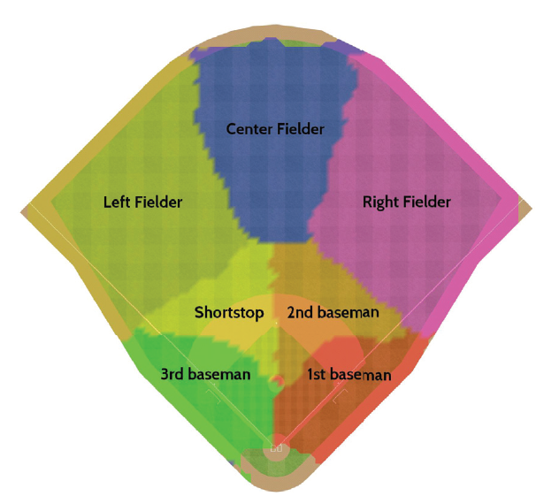
Understanding hit ball trajectories and player movements for different pitch types
Can be filtered by pitcher and batter name, game, inning, # balls and strikes, etc.
Use case: manager signals a particular pitch to induce a double play.

Slide 12
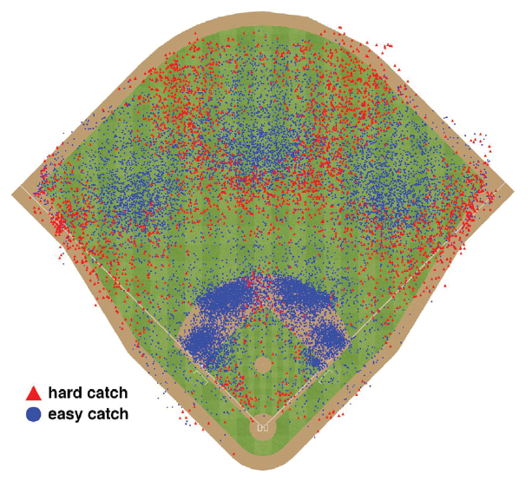
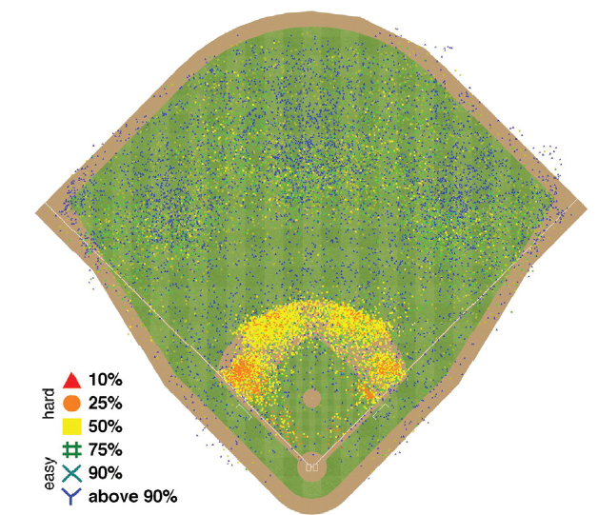
Analyzing defensive play difficulty
Motivation: Generally the number of errors is the only measure available to compare fielding performance.
1. Fielder’s running speed (i.e. at least 10.2 mph).
2. True Defensive Range (TDR). Probability that a hit will be fielded.
For example: Instead of saying if the player was able to catch the ball or not, use the time the ball was in the air and the distance from the fielder’s initial position.

Slide 13
To Summarize
Single gameplay, showing how visual elements augment the exploration of a reconstructed play.
Query capabilities over information from multiple gameplays to generate insight into specific game situations.
Analyze True Defensive Range (TDR) metric (spatiotemporal metric about defensive skill).

Slide 14
Q&A

Slide 15
References
IEEE Site Link
https://ieeexplore.ieee.org/Xplore/home.jsp
Presentation Paper Direct Link
https://ieeexplore.ieee.org/stamp/stamp.jsp?tp=&arnumber=7042478

